Slide 1

Predicting customer buying behaviour

Slide 2
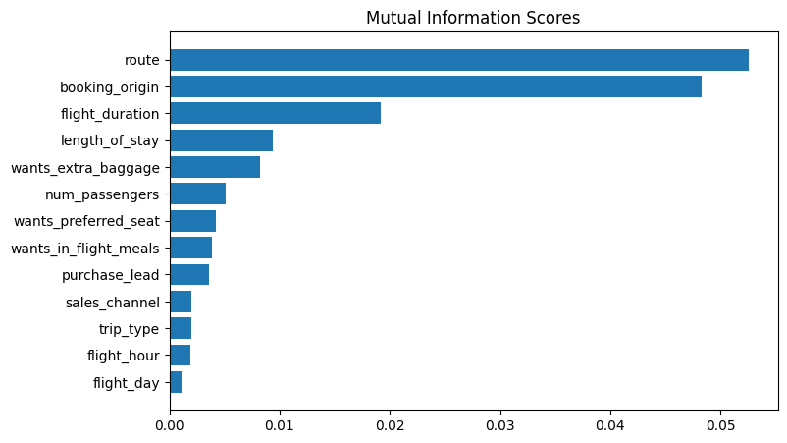
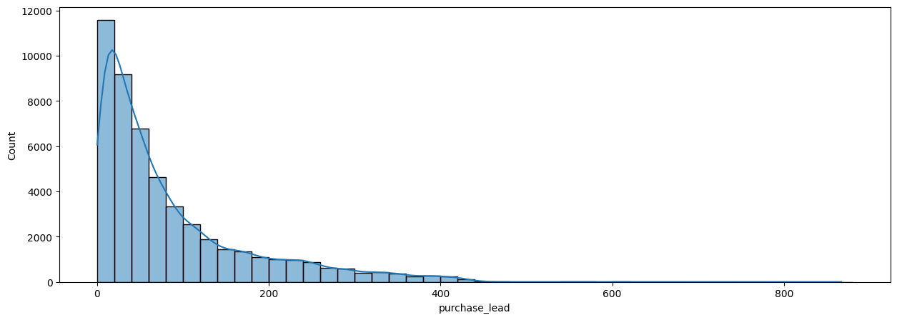
predictive model to understand factors that influence buying behaviour
We have trained the data set with Random forest classifier model and received
ACCURACY: 85.37
AUC score: 0.568
route
booking_origin
flight_duration
wants_extra_baggage
length_of_stay
are the top 5 features which influence
Customer buying behavior
We need to increase the AUC score.

